Slide 1

TITLE: Bikestore Database Project SUBTITLE: SQL Queries, Stored Procedure, Transactions and Views Presented by: Naraharinaik D Date: 20-07-2024

Slide 2
Introduction to “BIKESTORE”
The Bikestore database is a comprehensive dataset designed to manage and track various aspects of a bike store's operations. It is divided into two main schemas:
Productions
Sales.
Each schema contains multiple tables that represent different entities and their relationships within the store's ecosystem.

Slide 3
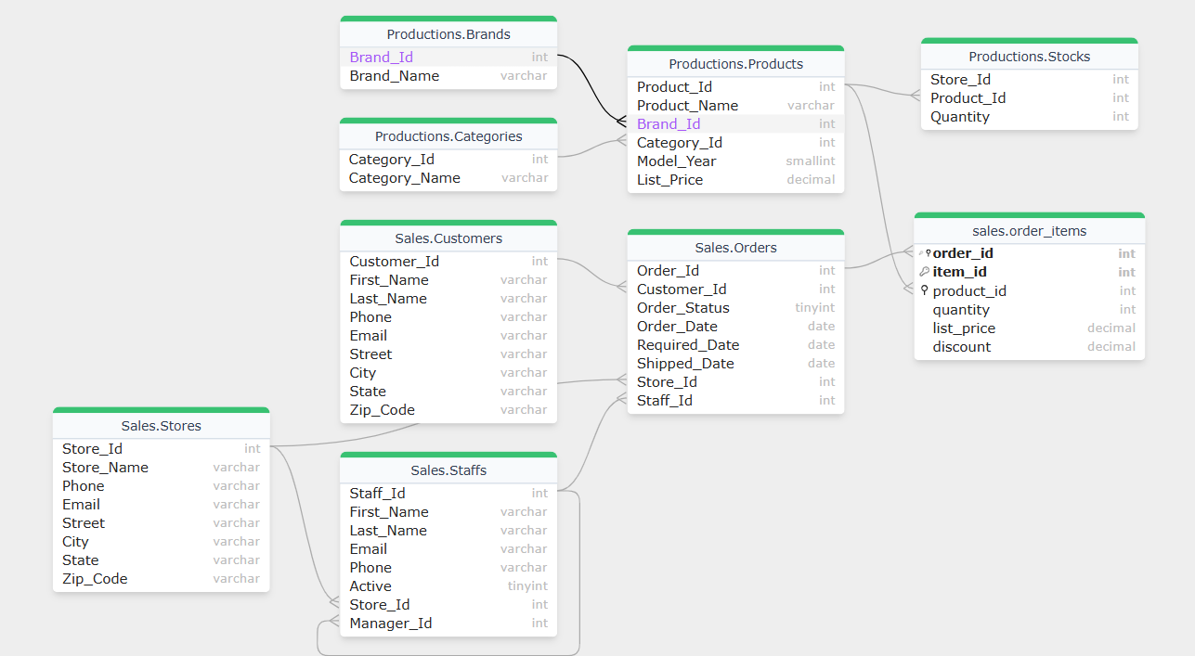
Bikestore Schema

Slide 4
Title: Project Objectives
Content:
Understand and manipulate database schemas.
Implement complex SQL queries.
Develop stored procedures for data operations.
Execute transactions to ensure data integrity.
Create views for simplified data retrieval.

Slide 5
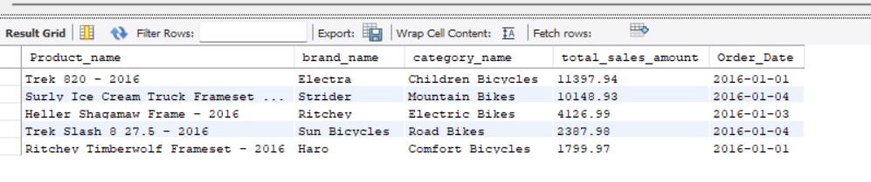
-- 1. Top 5 products with the highest total sales amount.

Slide 6
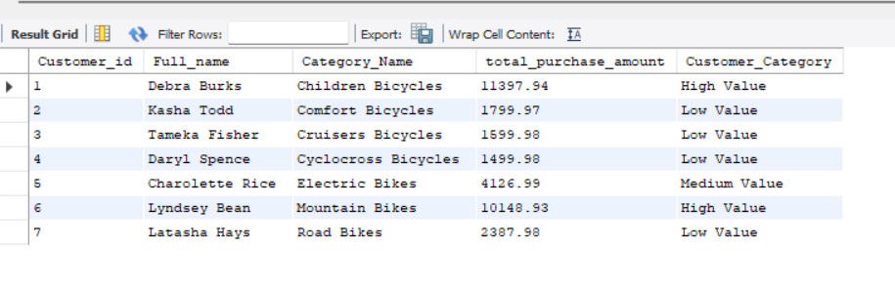
-- 2. Categorize the customers based on their total purchase amount into three categories: 'High Value', 'Medium Value', and 'Low Value'.

Slide 7
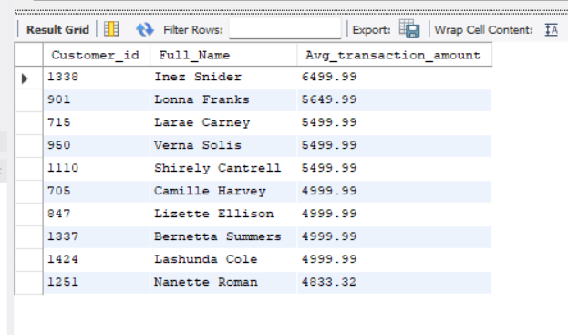
-- 3. Customers with the highest average transaction amount.

Slide 8
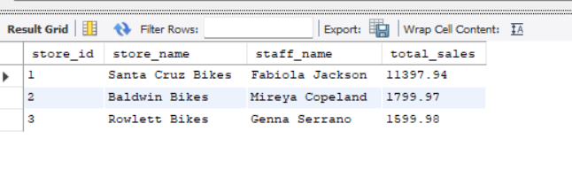
4. Show the total sales amount for each store.

Slide 9
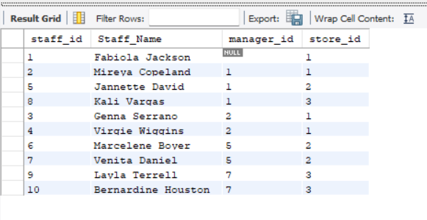
5. Using a recursive CTE, generate a report of all staff members and their reporting hierarchy.

Slide 10
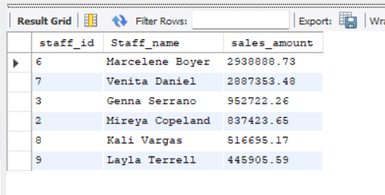
6. Calculate the total sales amount for each staff member:

Slide 11
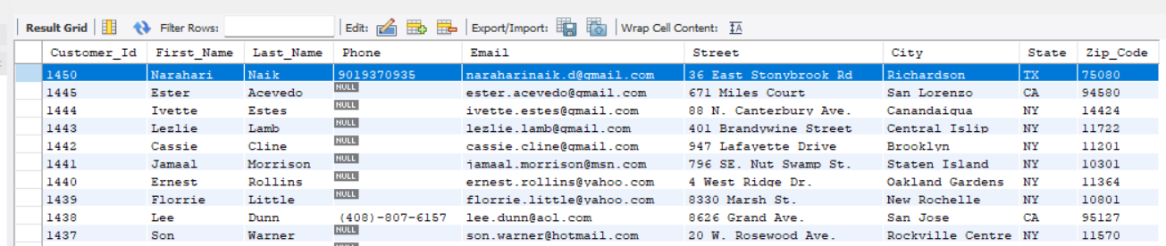
7. Create a stored procedure to insert a new customer

